Slide 1
19CSE461-Net centric Programming
Roll No : CB.EN.U4CSE19633
Name : M SANDEEP CHANDRA
Title of Application: Canteen Management System
Github URL : https://github.com/SandeepChandraMaddipati/Canteen_Management_System
Online URL : https://canteenmanagementsystem.netlify.app/

Slide 2
Modules
Login/register module
Cart module
Payment module
Feedback module
product module
oder module

Slide 3
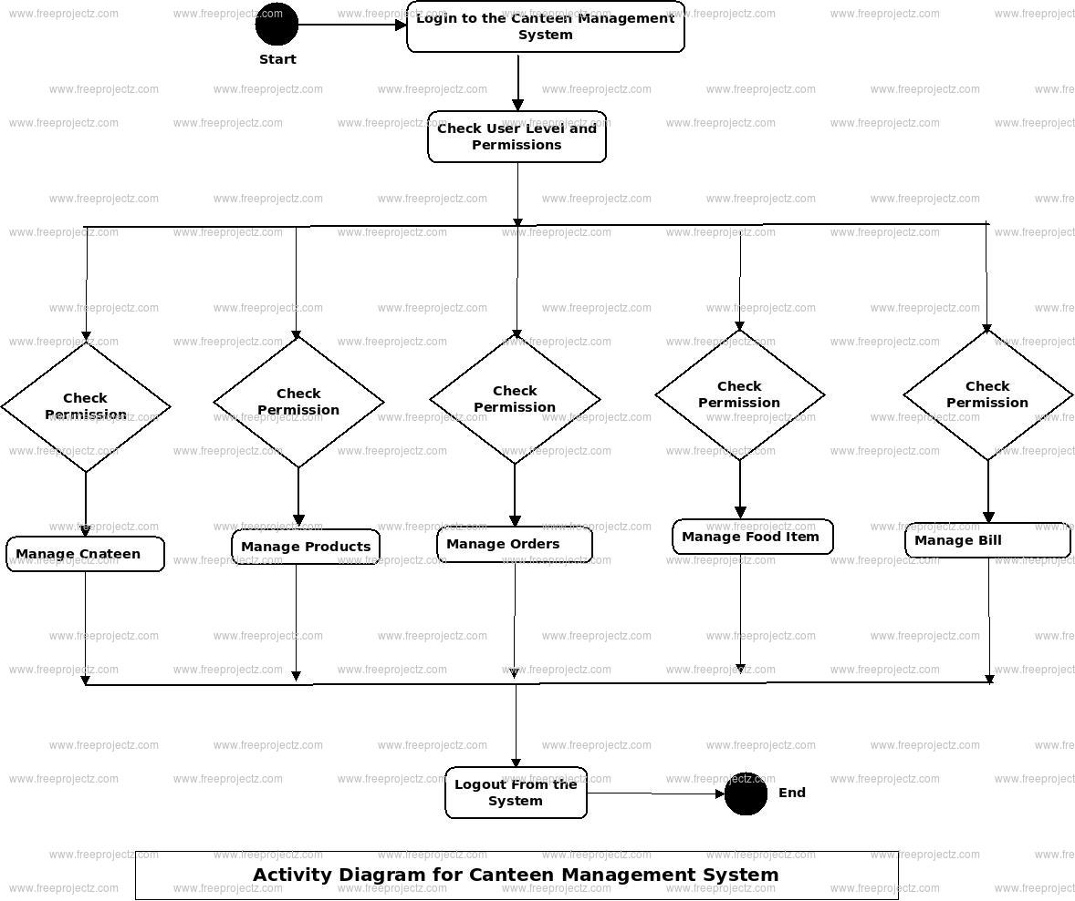
Block Diagram [Work Flow Diagram]

Slide 4
Technologies used in Mean stack
technologies/languages/framework/library​ | Purpose​
HTML5​ | Provide User interface to structure a web page and its content.​
CSS3​ | It applies styles to web pages to create attractive and user-friendly application​
MongoDB (v5.0.13)​ | NoSQL database to store and retrieve data across the web application​
NodeJS (v18.7.0)​ | It is used for server-side programming, and primarily deployed for non-blocking, event-driven servers, such as traditional web sites and back-end API services.​
AngularJS (v1.8.3)​ | powerful front-end development framework that offers Design Architecture, Code Reusability, Faster application development, Handles Dependencies.​
ExpressJS (v4.18.1)​ | Provides middleware packages to address almost any web development problem. There are libraries to work with cookies, sessions, user logins, URL parameters, POST data, security headers, and many more.​
JSON (v2.6.2)​ | It is commonly used for transmitting data in web applications​
XML (v1.1)​ | This provides a software- and hardware-independent way of storing, transporting, and sharing data​

Slide 5
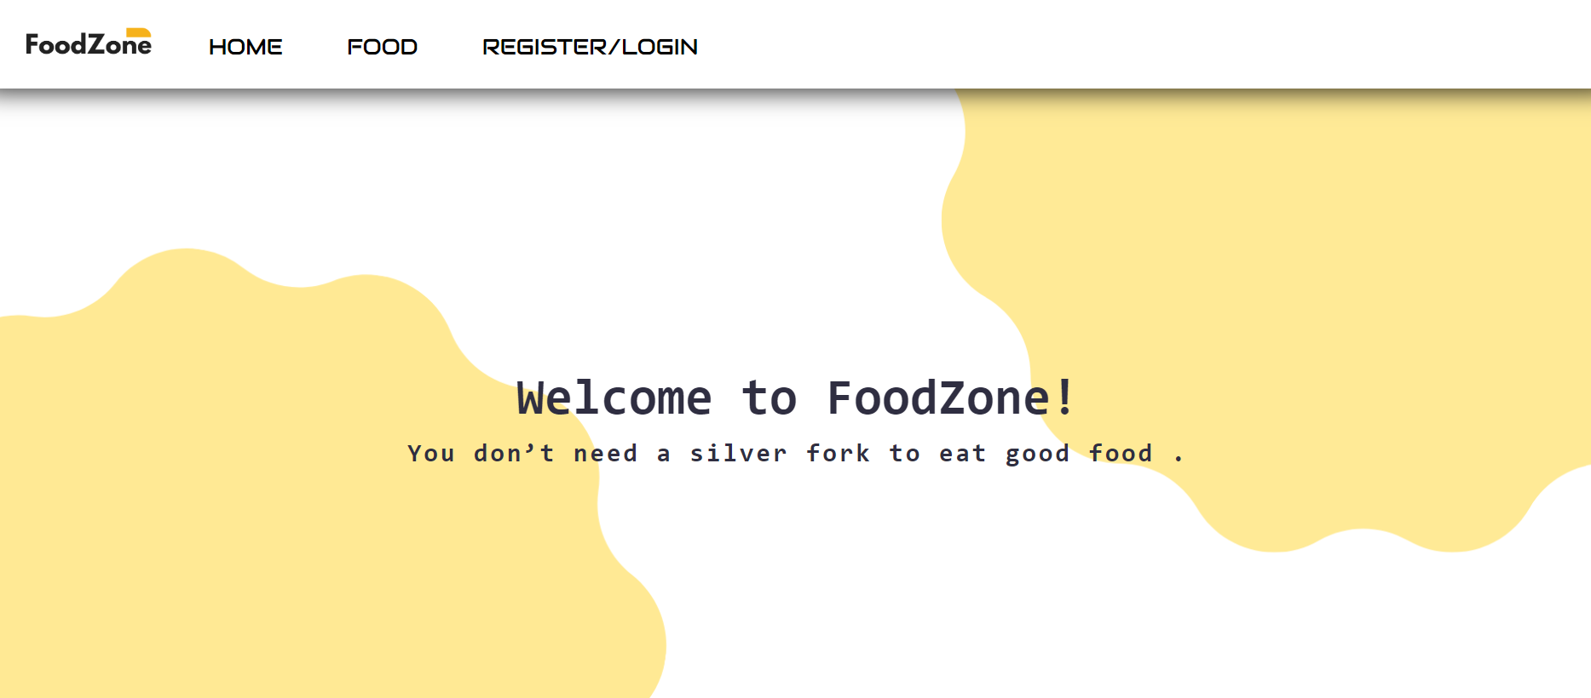
outputs

Slide 6
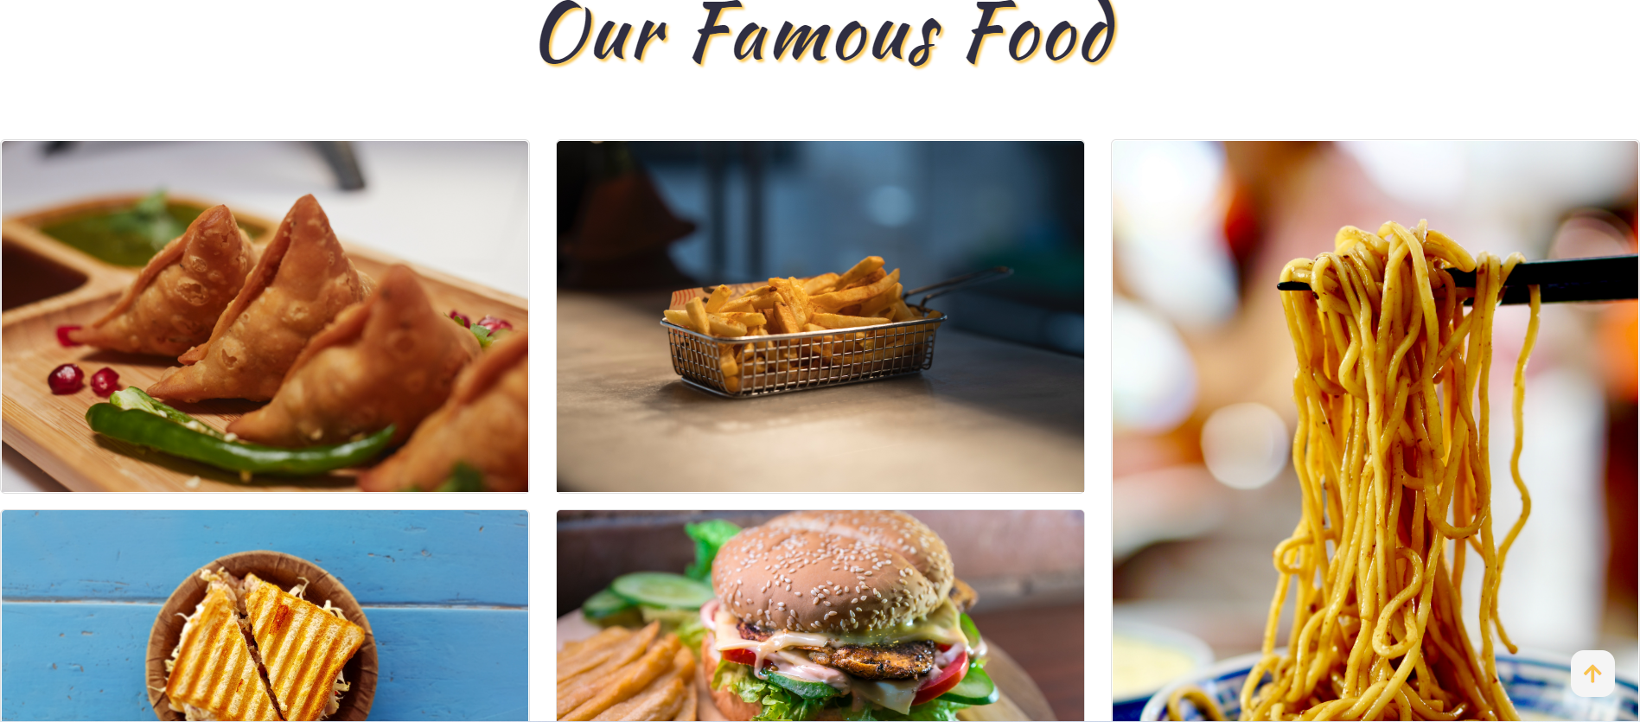
outputs

Slide 7
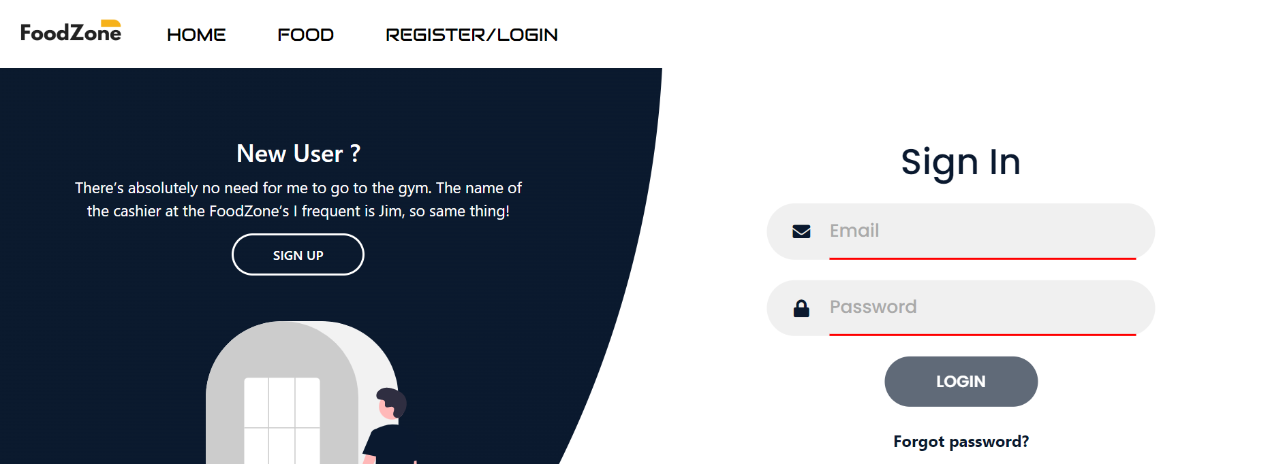
outputs

Slide 8
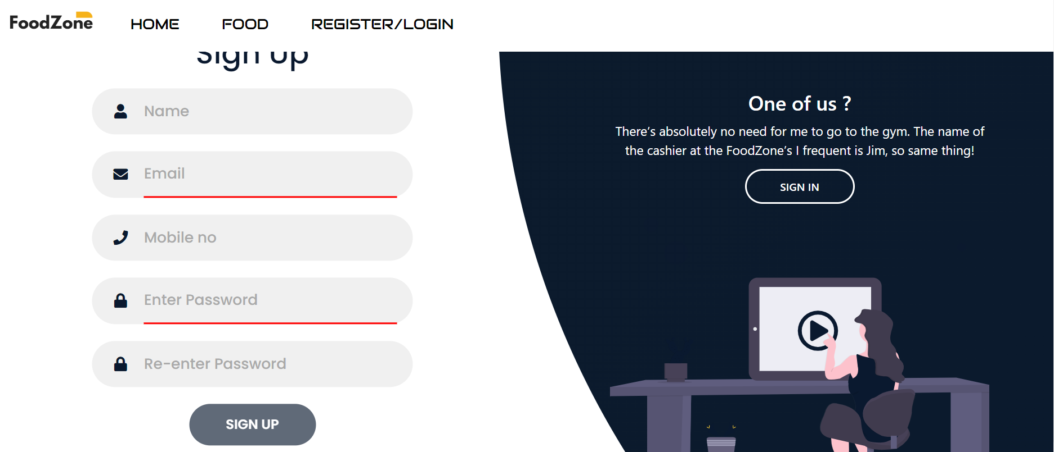
outputs

Slide 9
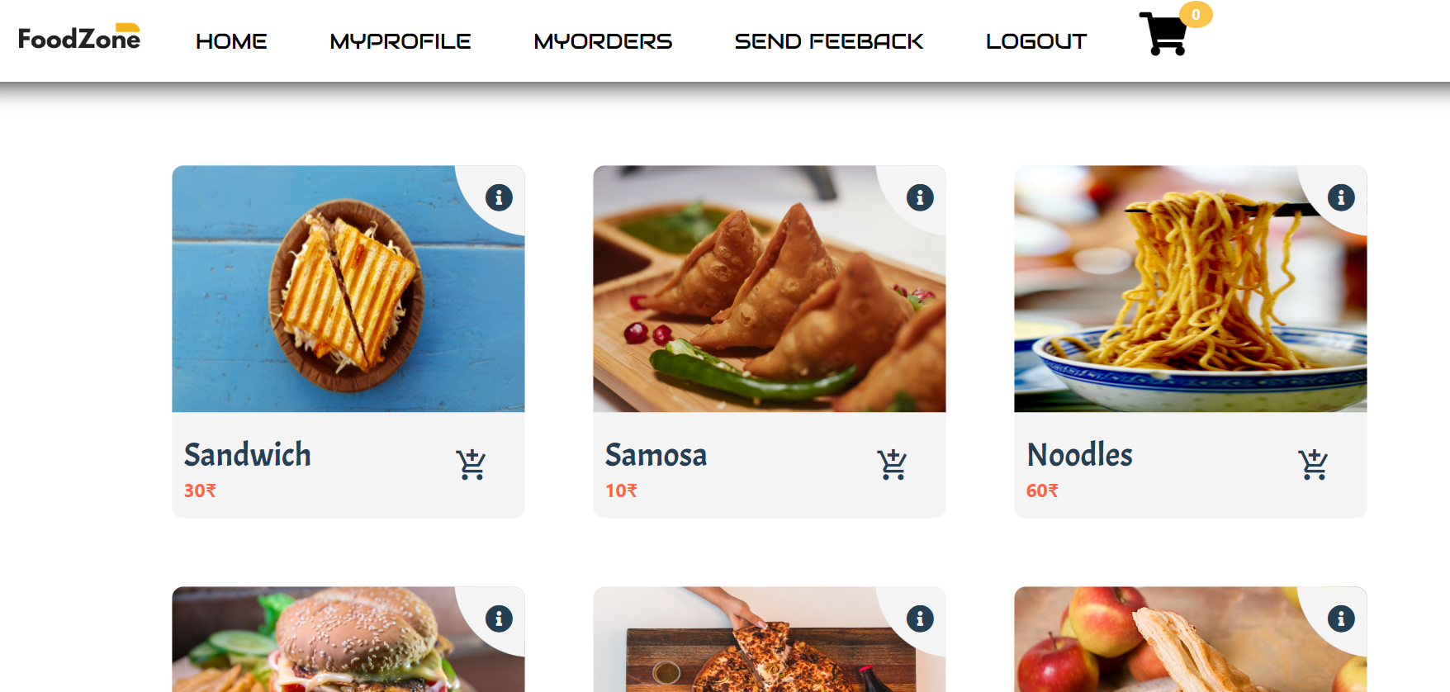
outputs

Slide 10
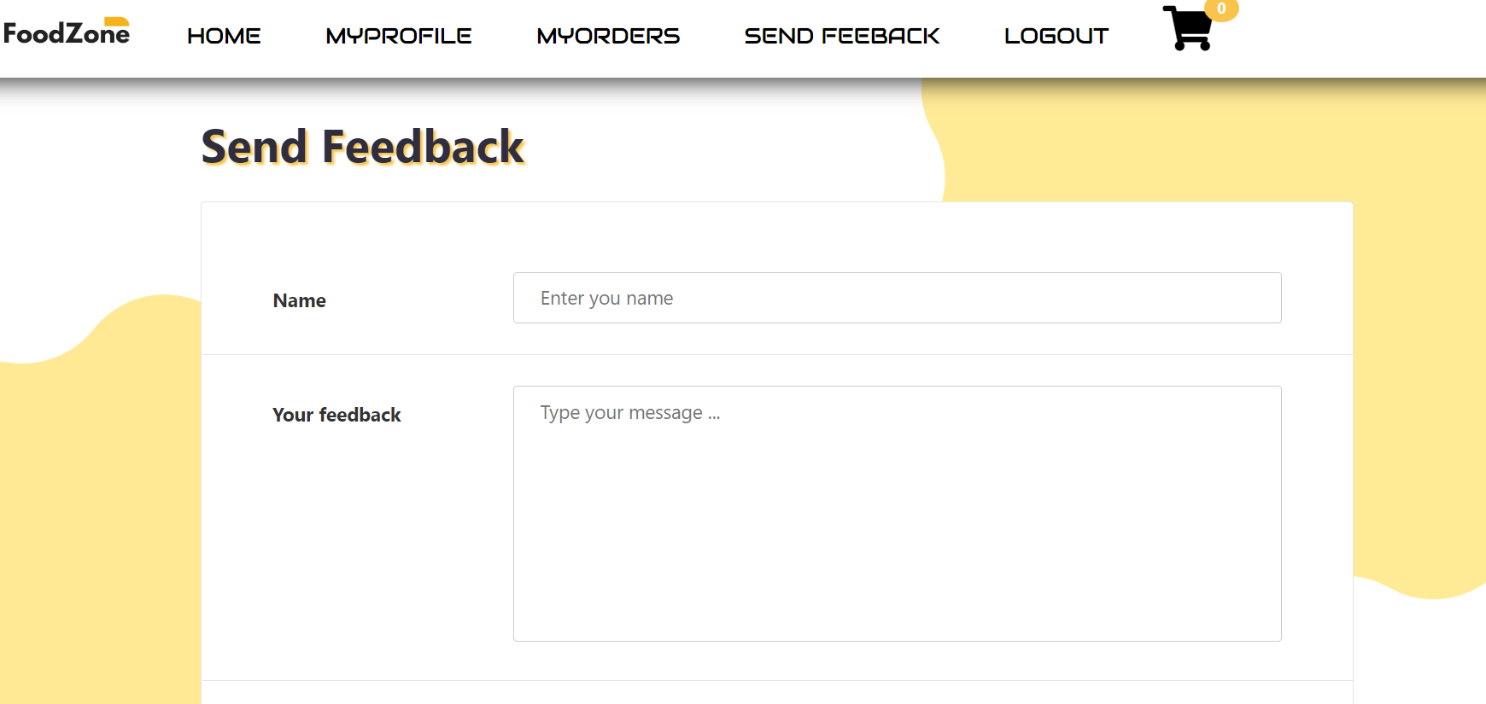
outputs

Slide 11
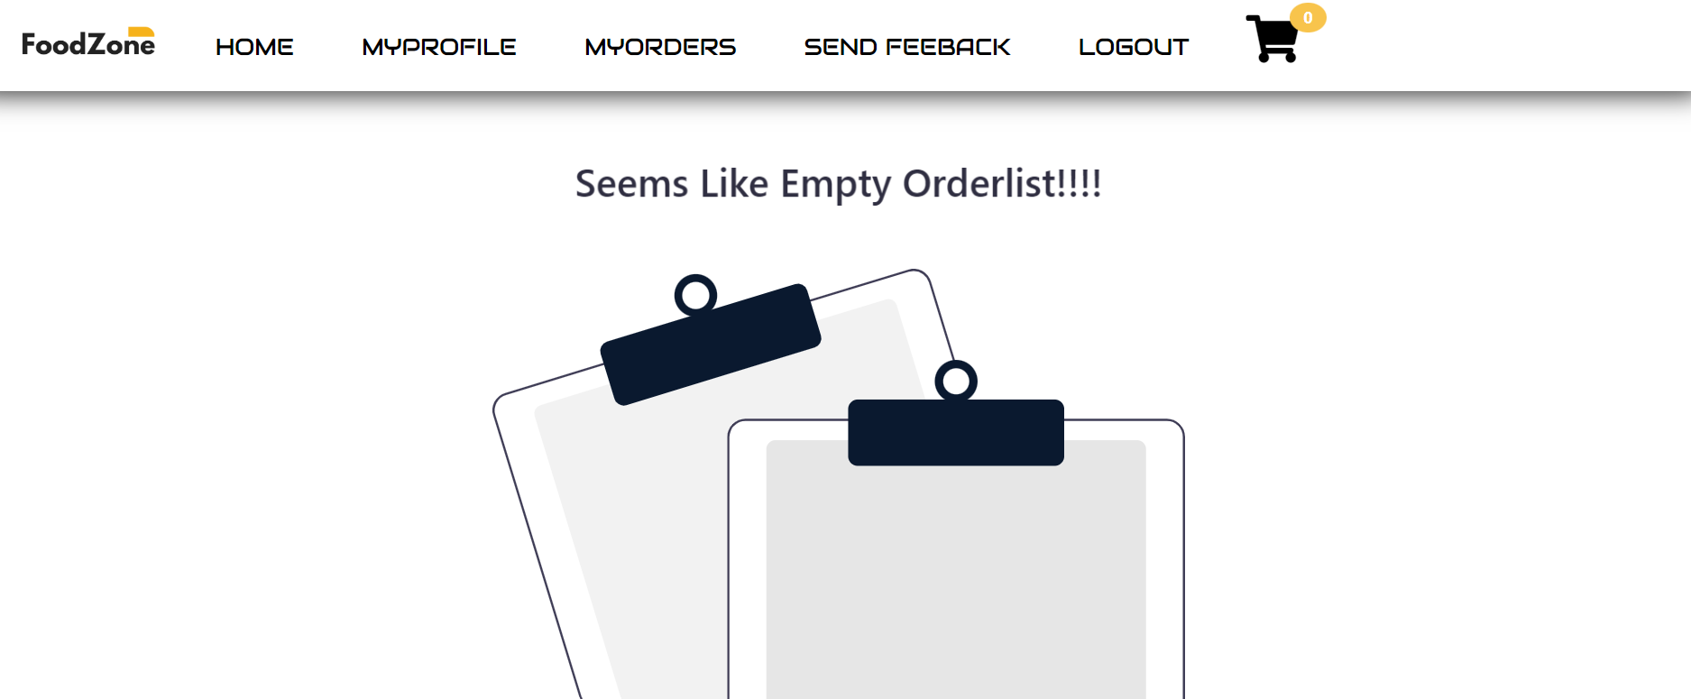
outputs

Slide 12
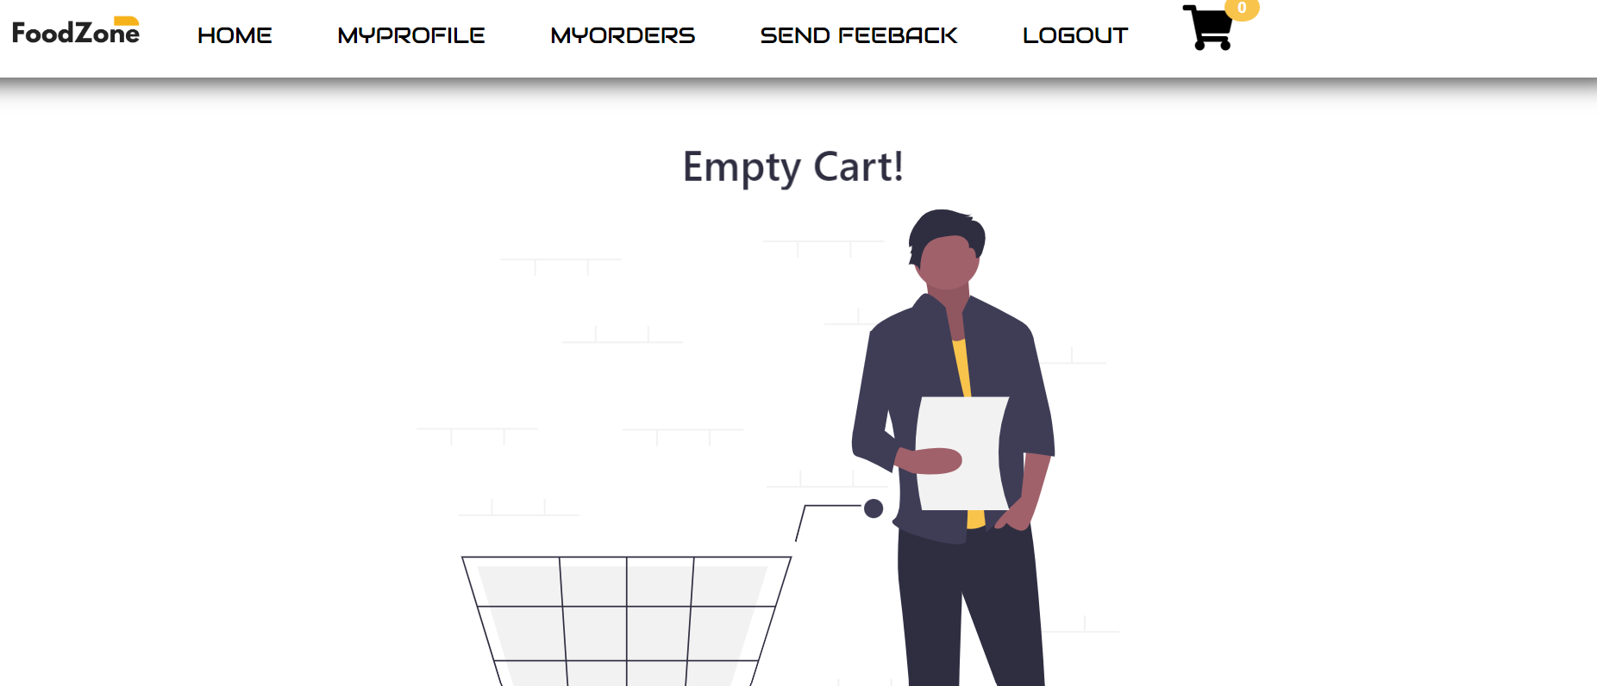
outputs

